Slide 1
Hybrid Monte Carlo method for scalar field theory
22-12-2021
Dirren van Vlijmen & Stefan de Wit

Slide 2
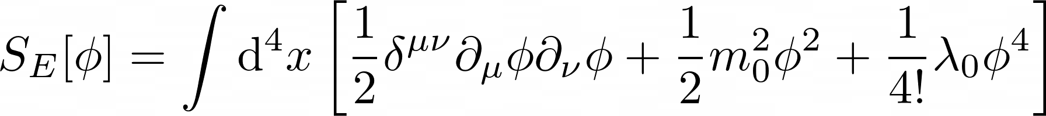
Field theories and discretization
Using path integral formulation and Wick rotation

Slide 3
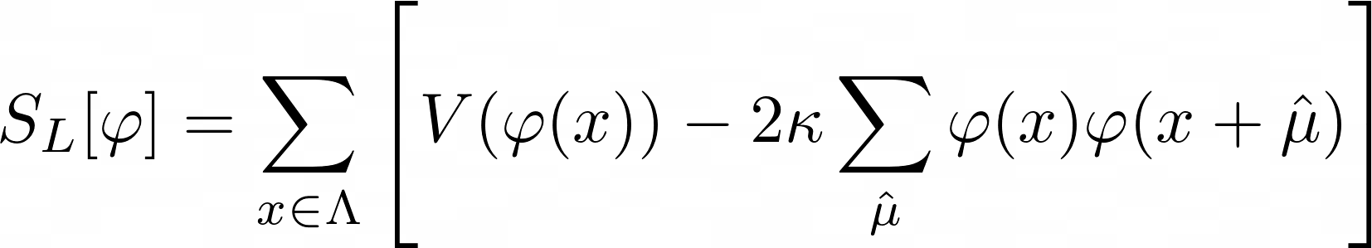


Field theories and discretization
Using path integral formulation and Wick rotation
Lattice discretization & rescaling
With:
$κ$ is analogous to temperature in the Ising model

Slide 4
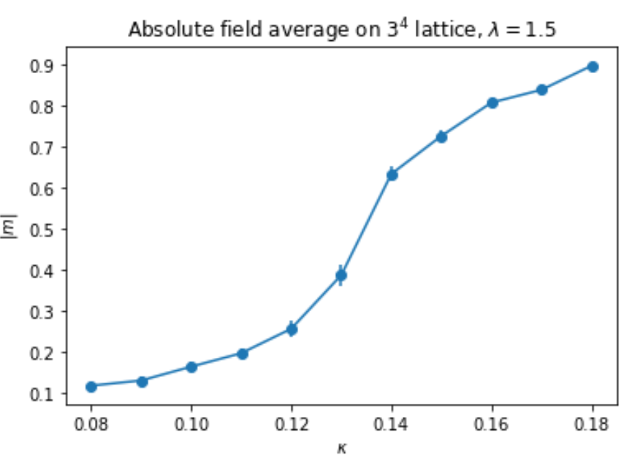

Metropolis Hastings
Using MH
Requires tuning paratmeter $δ$ to get acceptence ~50%
Image shamelessly stolen from the lecture notes

Slide 5
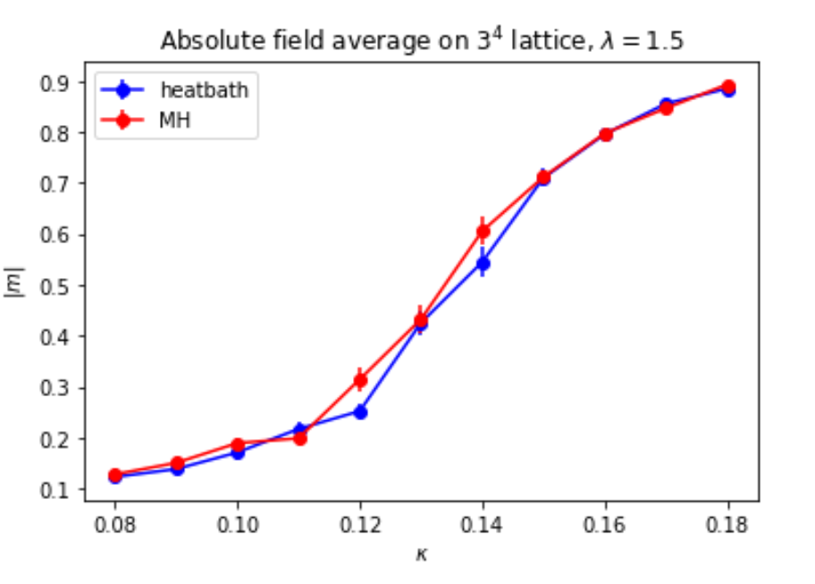
Heatbath algorithm
Rejection-free updating of single site.
Satisfies detailed balance.
Image shamelessly stolen from the lecture notes

Slide 6
Hybrid monte carlo
MH & Heatbath: Local updates
Slow for larger lattice sizes

Slide 7
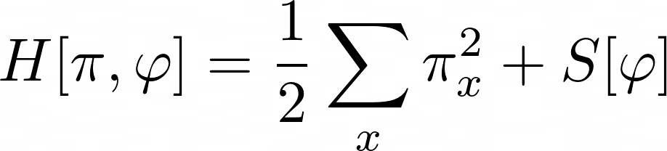

Hybrid Monte carlo algorithm (1)
Define Hamiltonian:
Sample canonical momenta: $π$(x)
Gaussian distributed

Slide 8
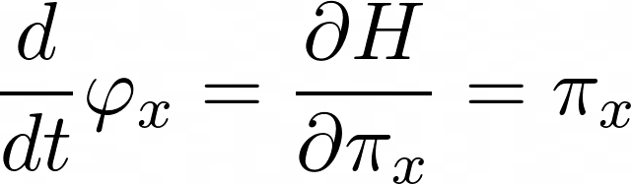
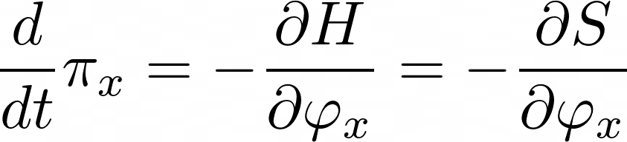
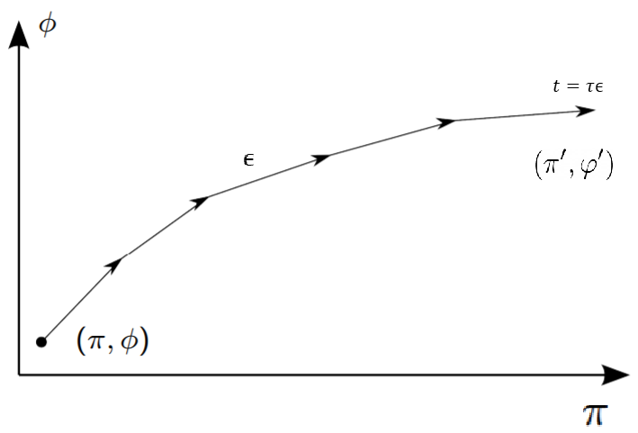

Hybrid Monte Carlo Algorithm (2)
Evolve$π, φ$ along a trajectory in the phase space
Hamiltonian dynamics
Discrete evolution:
Phase space trajectory

Slide 9

Hybrid Monte carlo algorithm (3)
$τ$ steps of integration: $\left(π,φ\right)→\left(π^{′},φ^{′}\right)$
Accept/reject
P=min{1,$e^{−ΔH}\}$
Resample $π$ for the next trajectory

Slide 10
Leapfrog integration (1)
If evolution of the fields was exact -> accepted always.
Can only approximate the integrals.
Use Leapfrog integration
Deterministic
Reversible
Area preserving
Simple

Slide 11
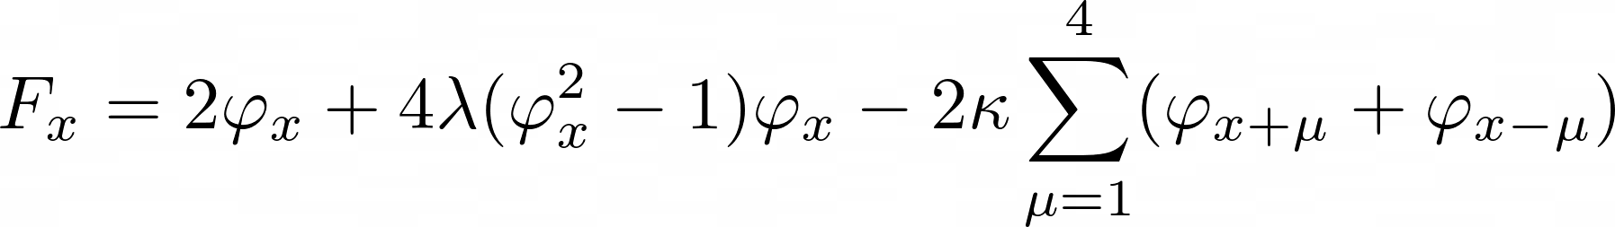

Leapfrog integration (2)
Start at (t=0) : $\left(π^{0}, φ^{0}\right)$
Endpoint (t=$τε):\left(π^{n},φ^{n}\right)$
Using:
With:

Slide 12
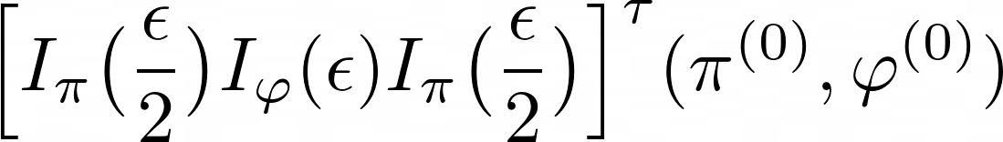
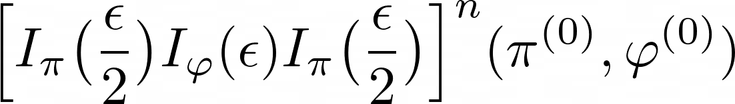

Leapfrog integration (2)
Start at (t=0) : $\left(π^{0}, φ^{0}\right)$
Endpoint (t=$τε):\left(π^{n},φ^{n}\right)$
Using:
$\left(π^{n},φ^{n}\right)$ =

Slide 13

Leapfrog parameters
Leapfrog is not exact
Errors are corrected by accept-reject step
Optimum: Set $ε \& τ$such that acceptance ~70-80 %

Slide 14
Detailed balance
Leapfrog integrator is reversible and area-preserving.
Still difficult to check explicitly that detailed balance is satisfied
Instead: compare distributions with MH/Heatbath

Slide 15
Goal
Implement Hybrid Monte Carlo Algorithm for lattice scalar field theory
Improve and compare convergence speed and lattice size

Slide 16

Difficulties
Detailed balance check
Finding optimal values for $ε, τ$ whilst considering the equilibration phase, correlation time and acceptance rate.
Running finetuning scripts

Slide 17

Difficulties
Detailed balance check
Finding optimal values for $ε, τ$ whilst considering the equilibration phase, correlation time and acceptance rate.
Running finetuning scripts
How to efficiently update the entire field
Calculate the Force

Slide 18
(preliminary) Results
Still Running simulations
HMC much faster
Especially for larger lattices
Much faster equilibration
Heatbath vs MH:
Larger peak around phase transition for heatbath
Seems to even out for larger lattice

